Slide 1
Morphological Operators
CS 111: Digital Image Processing
Notes:
‹#›

Slide 2
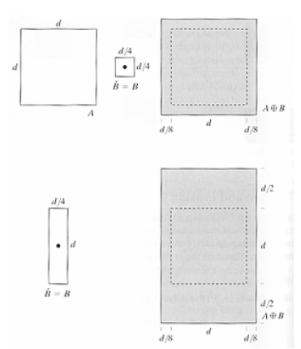
Dilation
Notes:
‹#›

Slide 3
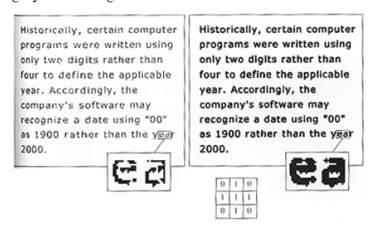
Dilation: Join Broken Segments
Notes:
‹#›

Slide 4
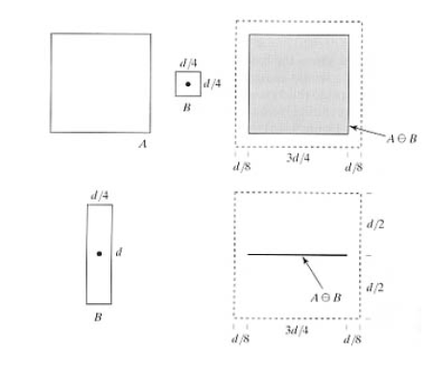
Erosion
Notes:
‹#›

Slide 5
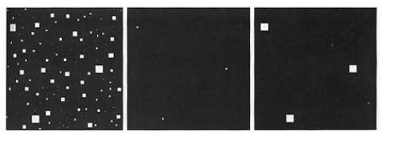
Erosion and Dilation: Eliminating Irrelevant Details
Notes:
‹#›

Slide 6
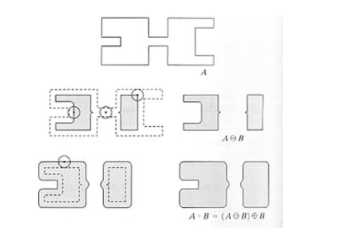
Opening
Notes:
‹#›

Slide 7
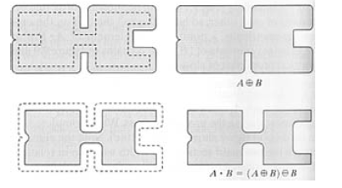
Closing
Notes:
‹#›

Slide 8
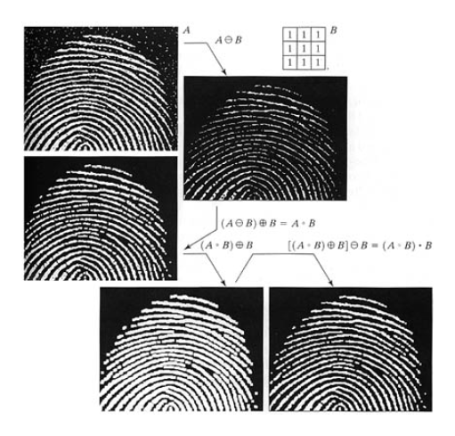
Opening and Closing: Noise Filter
Notes:
‹#›

Slide 9
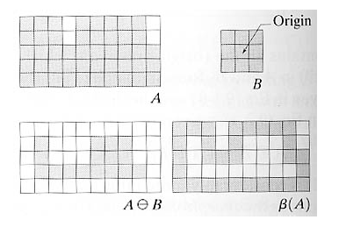
Boundary Extraction

Slide 10
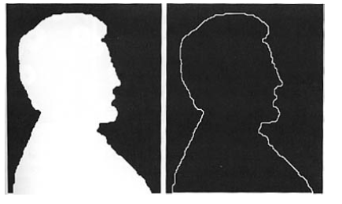
Region Filling
Notes:
‹#›

Slide 11
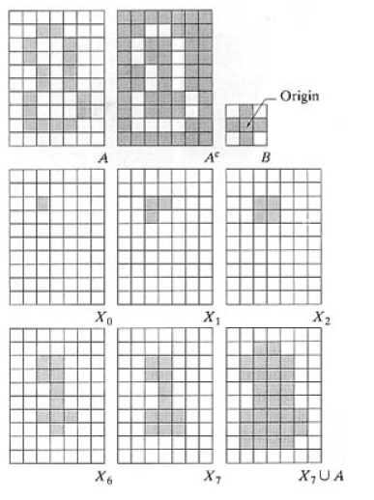
Region Filling
Notes:
‹#›

Slide 12
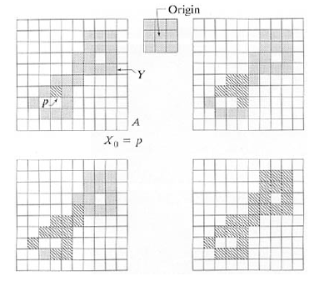
Connected Components
Notes:
‹#›

Slide 13
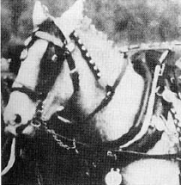
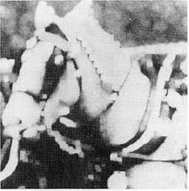
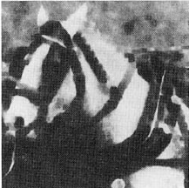
Gray Scale: Dilation and Erosion
Original
Dilation: Brighter where small dark details are reduced
Erosion: Darker where small bright details are reduced
Notes:
‹#›

Slide 14
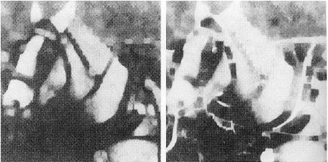
Gray Scale: Opening and Closing
Original
Opening: Reduces small bright details with little effect on dark areas.
Closing: Reduces small dark details with little effect on bright areas

Slide 15
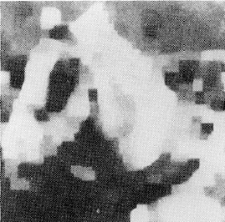
Smoothing: Opening and then Closing

Slide 16
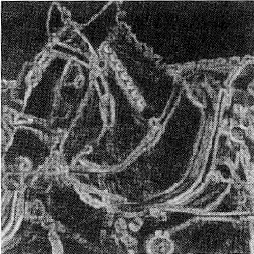
Gradient: Dilation - Erosion
Morphological Edge Detector
Direction Independent

